Slide 1
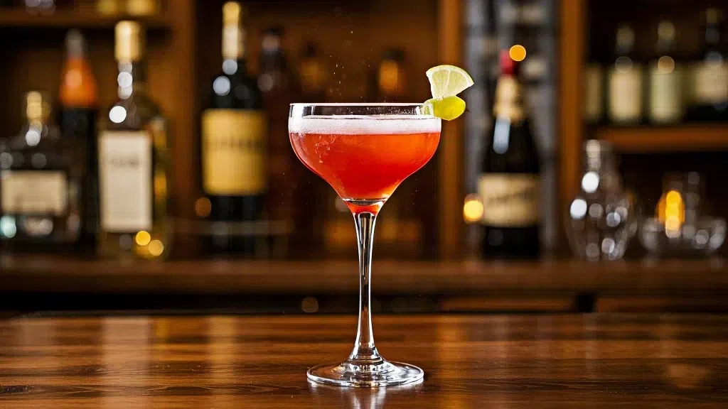
IS6620 LLM and Prompt Engineering
--Cocktail Recommendation Chatbot
The project objective is to develop a chatbot, which can accurately recommend cocktail along with the reasons by fine-tuning a large language model with some datasets of cocktail reviews.
——Project 2

Slide 2

02
Introduction _ Business Context
Pain points for customers
Alcohol culture has a certain barrier for beginners, especially in diverse social occasions.
When faced with dazzling brands and complex labels of alcohols, consumers may find it difficult to quickly determine on suitable products that can satisfy both their tastes and their social needs.
Meanwhile, professional alcohol websites lack convenient recommendation systems.
On the one hand, beginners need to face a large number of professional terms rather than a system that can understand their demands and provide suggestions in comprehensible languages.
On the other hand, consumers have to waste their time on browsing through the webpages until finding a satisfying result rather than getting everything done with a few commands.
Our recommendation system will focus on cocktails
Because the labels of cocktails are often more confusing and we believe our cocktail chatbot will help with distinguishing them.
Also, cocktails can cater to a wider range of needs of consumers, as their diverse appearances and entertaining production process give them richer social values.
(58887807) 2

Slide 3


01
Introduction _ Solutions and Deliverables
Solution Components
Deliverables Introduction
Our key components include the following parts:
Frontend: a cocktail recommendation system with an interactive webpage
Backend: the complete chatbot code based on LLM
Data: data used for fine-tune and RAG method
Three functions available:
Users can ask the chatbot for cocktail recommendations through an html webpage.
They can also use a search engine which is linked to an external website to search for related information.
Save their favorite products to a collection page for later reference.
In summary, we developed three interactive functions for our cocktail recommendation system, and we ensured ease of use with a simple and clear interface. To go further in business, our system can be integrated with websites owned by major liquor companies to enhance customer experience and loyalty.
The major part of our implementation that focused on LLM is the backend development of the chatbot.
For the chatbot development, we used two different LLM methods, fine-tuning and RAG.
Fine-tuning: based on the TinyLlama-1.1B model, and we found that the fine-tuned chatbot would generate correct answers in logical formats.
RAG: answers can be generated from an external ILM API equipped with a vector database, with minimal device limitations and easy modification of data formats.
(58887807) 3

Slide 4


02
Methodology _ Front-end and Back-end Design
Front-end design
Using Cascading Style Sheets code, we designed the front-end interactive page. We set the background color, calligraphic style, and card style in the webpage and made it easy to operate and user-friendly through different settings:
Distinguish different interaction situations by button colors: the main button (.btn-primary) is blue, green represents successful operation (.btn-success), and yellow represents operation warning (.btn-warning)
Enhance user experience through mouse hover effects (transform: translateY (-5px))
Well displayed on different screens: defining a container class (.container) with a maximum width of 800px.
Backend design
The backend application is designed to process interactions from the front-end webpage.
Based on Flask, it is a complete cocktail chatbot, which includes the three major functions mentioned in the introduction:
Chatbot (“Ask About Cocktail”)
Search engine (“Search Cocktail”)
Favorite collections (“Favorite”).
(58947280) 4

Slide 5



02
Methodology _ Fine-tune method
During the fine-tuning process, due to the limitations of CPU operation of our device, we:
Defined two sets of fine-tuning dialogues, converted the format of the two dialogues into IDs and attention masks;
Set the parameters epoch=10, batch_size = 1, learning_rate = 5e-6;
The fine-tuning time was about 35 minutes.
Chatbot
Search engine
Favorite collections
The chatbot can recommend suitable product names with brief introductions based on the user’s query.
Through the /ask function, an API interface is established and collects front-end queries.
The back-end code generates answers based on the TinyLlama-1.1B-Chat-v1.0 model, with a maximum token count of 200.
This function links to the URL for a cocktail website: https://www.thecocktaildb.com/api/json/v1/1/search.php?s={cocktail name}.
The backend receives queries through /search_comtail and collects website information through the API.
Through the external information, users can have more understanding of the suitable cocktails which the chatbot recommends. This function aims to facilitate instant search and supplement the answer of the chatbot.
As a personalized functionality, the goal is to increase the usability of the recommendation system by enabling users to mark their favorite cocktails.
We imported sqlite3 to create a database, set /add_favorite, /remove_favorite and /favorites API routes with 'GET', 'POST', and 'DELETE' methods to display, add, and delete contents in the “Favorite” page.
(58819313) 5

Slide 6
02
Methodology _ RAG method
Since RAG is flexible for device limitations and allows us to use more data, we first processed the data based on Cocktails.csv to capture the meaning of texts. The processing procedure is as follows:
Segment cocktail information into multiple chunks by the BAI/bge-based en-v1.5 model, then capture vector information.
Store the cocktail vectors in a newly created SQLite database.
Chatbot
Search engine
Favorite collections
Compared with the fine-tuning method, instead of using the 1.1B model, we employed a prompt engineering approach by deepseek-chat-v3-0324:free model. Then, the output format has been standardized in the main program file on the backend.
For the answer query, we used both the vector databases through an embedding model named BAAI/bge-base-en-v1.5 and an API interface of Deepseek model named openrouter.ai by using URLhttps://openrouter.ai/api/v1/chat/completions.
We classified text based on semantic information captured by vectors, stored information using SQL statements, and displayed information through SQL queries and API calls.
In the searching process, we first considered the matching of the exact name. If the exact name could not be matched, we would do the search under vector similarity, including overall text similarity, cocktail ingredient similarity, and cocktail menu similarity. Meanwhile, unified the format of the search results.
The logic has not been changed because of its characteristics.
(58581879) 6

Slide 7
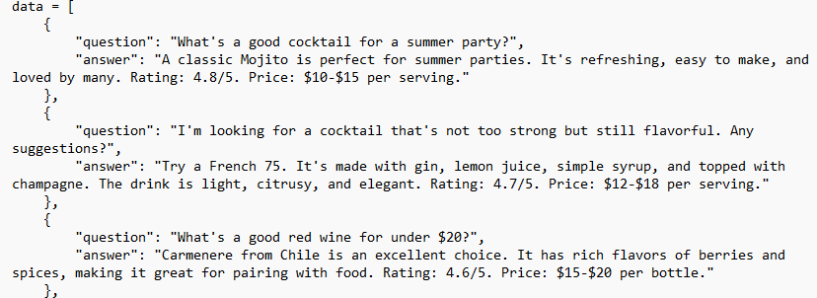
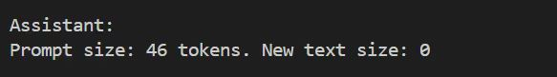
02
Challenges _ Training Data Size
The main challenge we faced during the implementation stage was to find a balance between the training cost and chatbot response accuracy for the fine-tuning approach. In order to reach a reasonable training time and a desirable level of accuracy, we needed to decide on the proper size of our training dataset and set appropriate numbers to the fine-tuning parameters (e.g., epoch, batch size, and learning rate).
1. Around 30,000 liquor reviews from Kaggle
2. Only one Intel-I7-14700 CPU for training
3. Reduce training data
4. Ask ChatGPT to generate some representative liquor recommendation data
5. Start from feeding a small number of data pairs and gradually added more
6. Challenge: When the amount of training data was too small, the model would give us empty reply which was inaccurate and not acceptable.
7. Solution: Using 20 data pairs would control the training time to approximately 35 minutes and enable the model to provide meaningful responses.
(58838131) 7

Slide 8
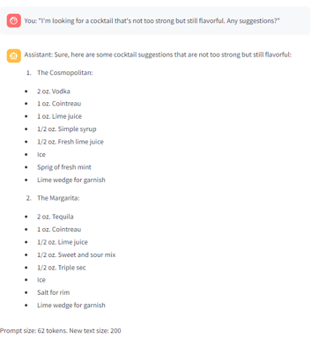
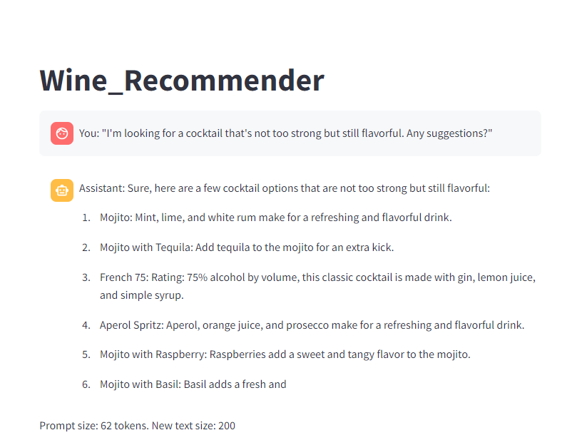
02
Challenges _ Parameter Modification
When the parameters were set as epoch = 2, batch_size = 2, and learning_rate = 2e-5, the result is not formatted as our training data. It did give us a menu of cocktails together with their components. but we expected a conversation-like answer with more “subjective” descriptions (e.g., flavors, tastes, effects, etc.) of the alcohols.
After manually changing the parameter values, we found that setting epoch = 10, batch_size = 1, and learning_rate = 5e-6 would give us desired results.
epoch = 10, batch_size = 1
learning_rate = 5e-6
epoch = 2, batch_size = 2
learning_rate = 2e-5
(58838131) 8

Slide 9
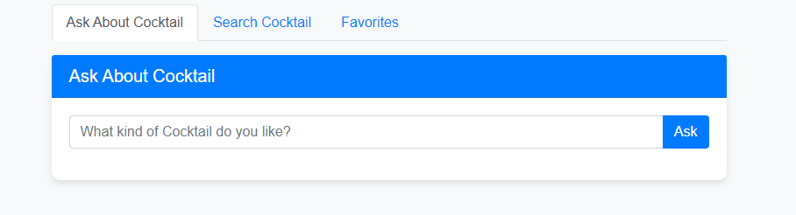
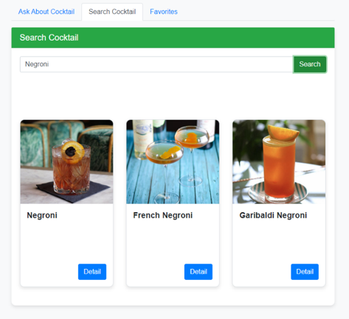
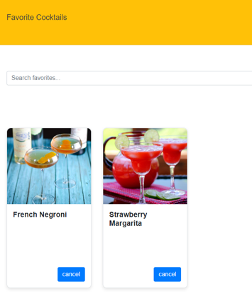
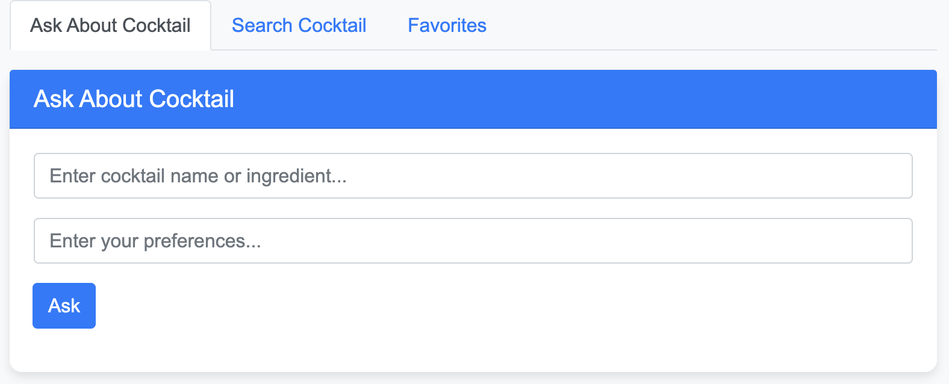
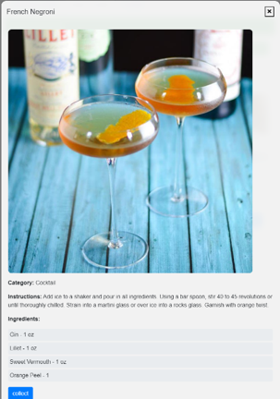
03
Results _ Front-end webpage
01 Chatbot
02 Search Engines
03 Favorite collections
Fine-tuned Chatbot
RAG Chatbot
(58868018) 9

Slide 10
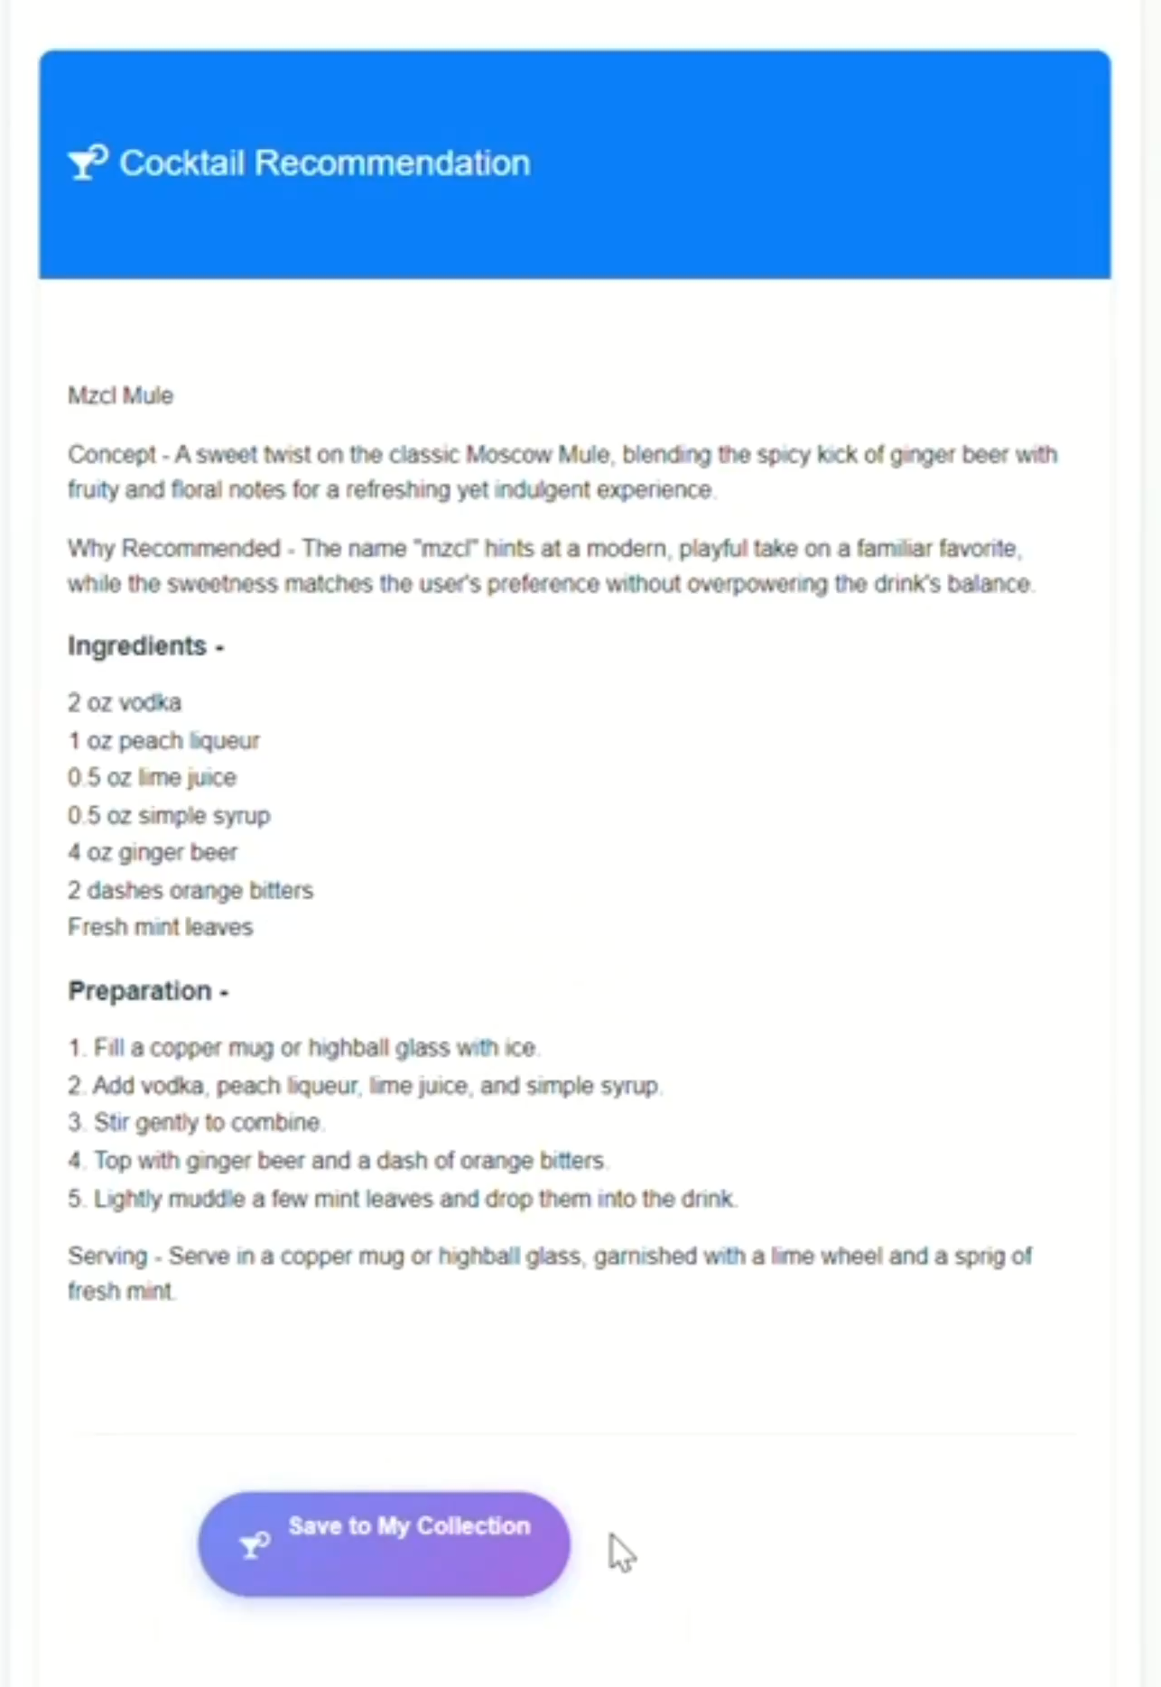
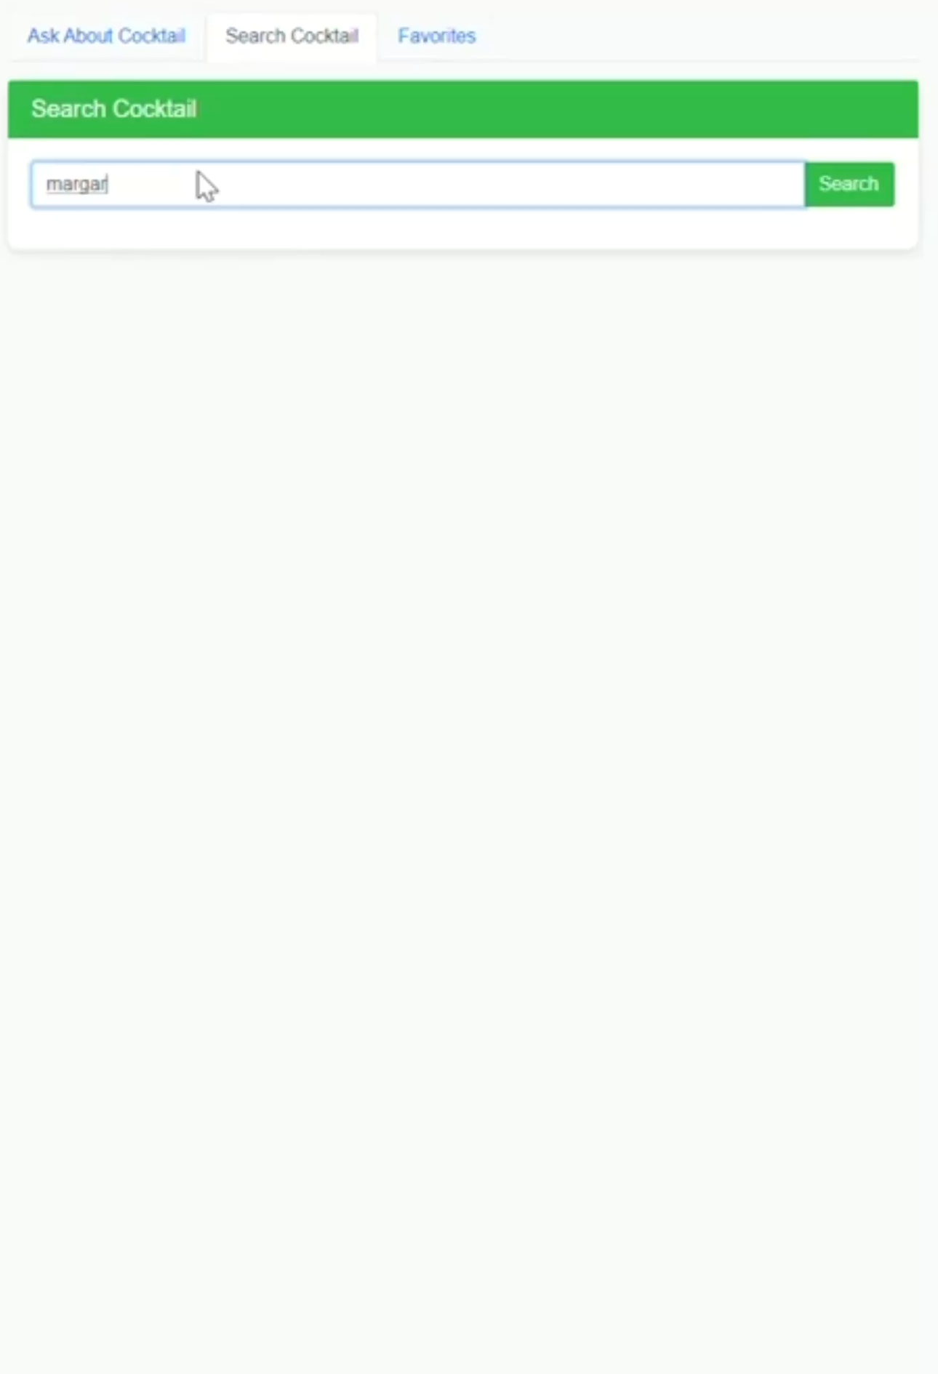
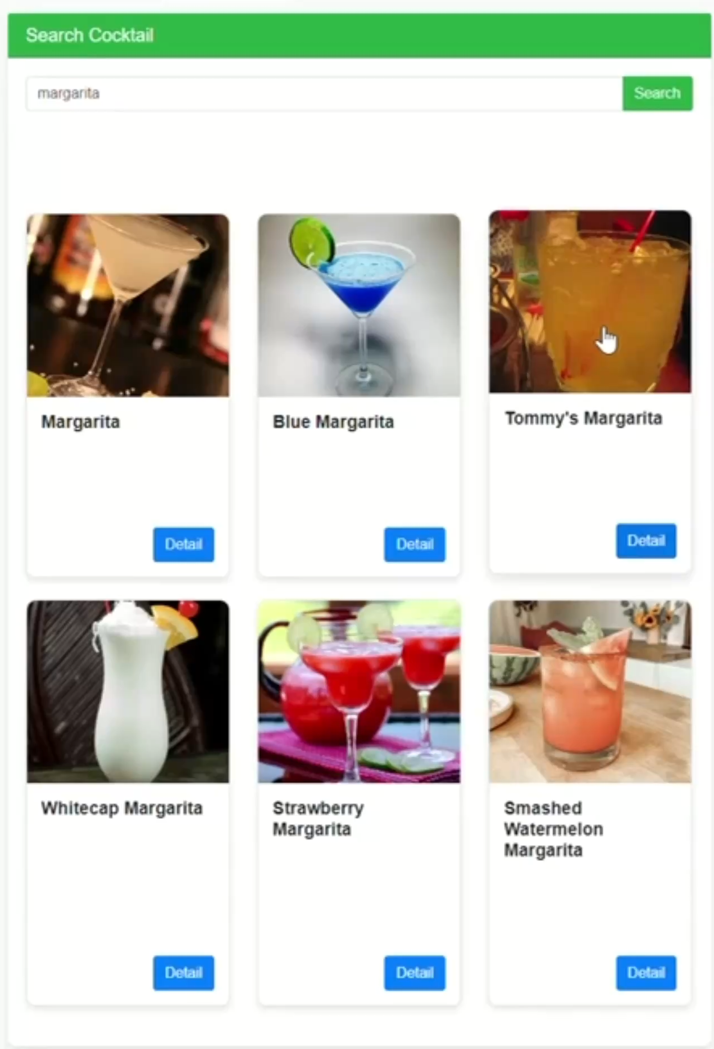
03
Results _ Demonstration
01 Chatbot
02 Search Engines
03 Favorite collections
(58868018) 10

Slide 11
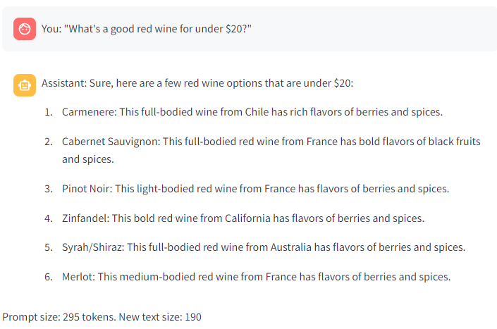
03
Results _ Fine-tune results
Parameters: “epoch = 10, batch_size = 1, learning_rate = 5e-6”, the result is reasonable.
Format: brief and unified, which is "Cocktail Name: Brief Explanation".
The optimized recommendations not only cover the names of cocktails but also give a brief summary in one sentence (including ingredients, alcohol content, flavor, menu, drinking scenario, etc.) , which encourages users to use the search function to access more complete information online.
In summary, new customers can quickly select suitable cocktails that meet their expectations by using our recommendation system, increasing their interest and willingness to purchase cocktail products.
(58868018) 11

Slide 12
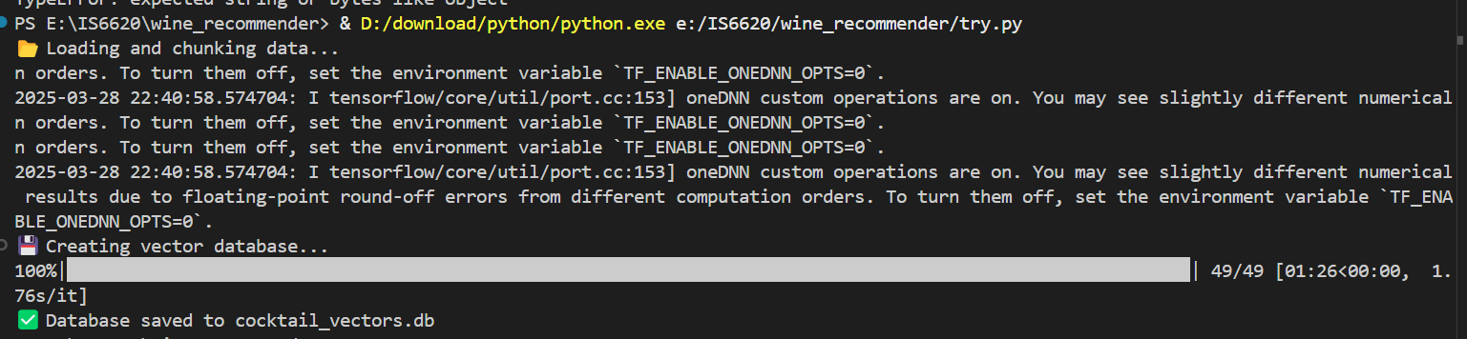
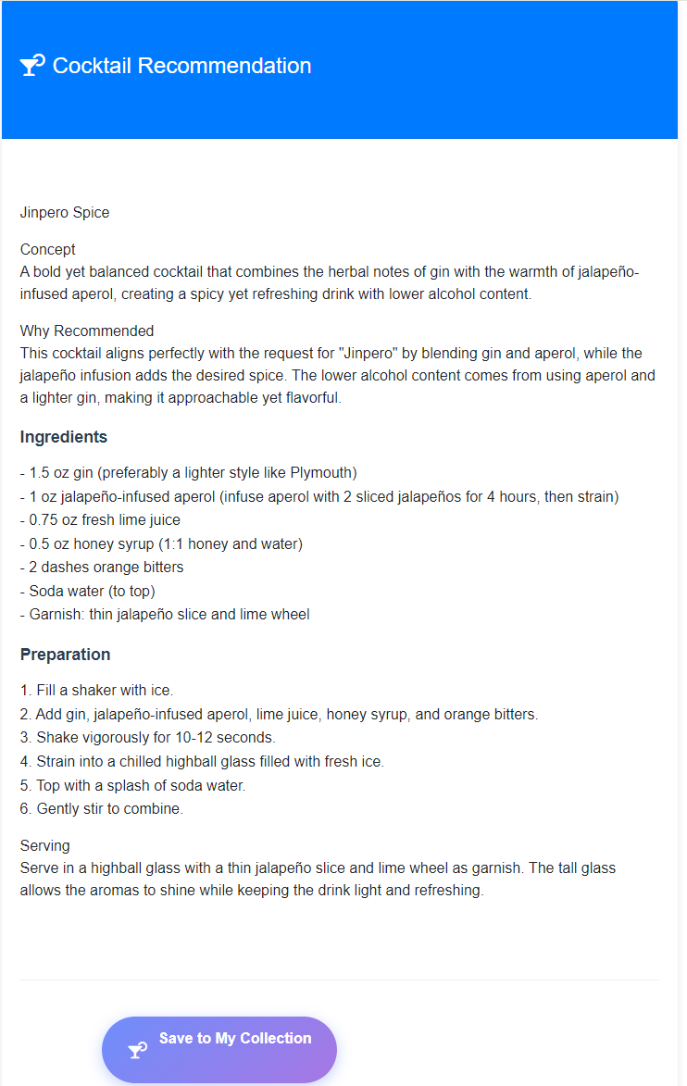
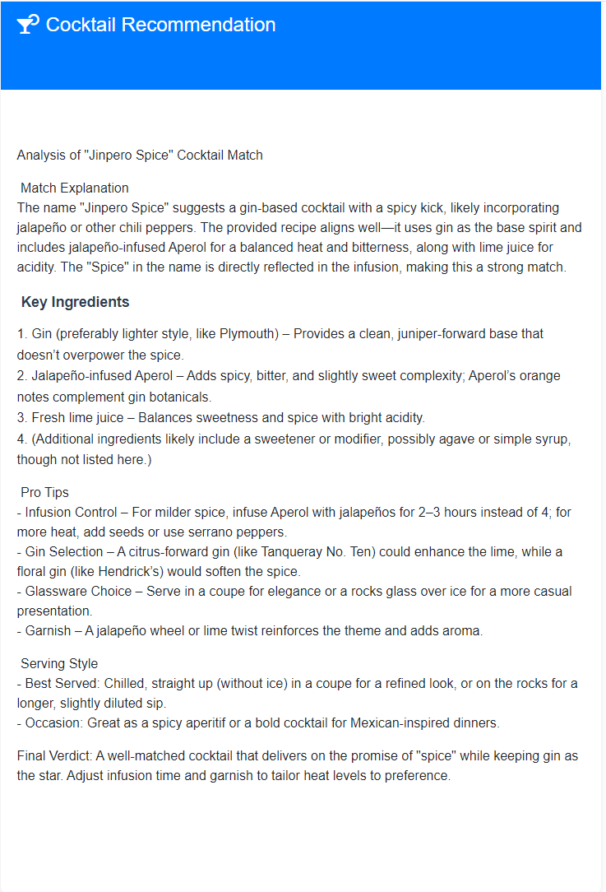
03
Results _ RAG results
1. Vector database generation:
2. Data retrieval:
chunk_Size=500 chunk_overlap = 50, batch_size = 16. The overlap can reduce information loss and improve subsequent accuracy of searching.
We successfully converted the information in the Cocktails.csv into vectors, then saved them in the database cocktail-vectors.db.
The chatbot cannot find the corresponding answer by searching the vector database
Use prompt engineering
1. LLM will guess the specific products
2. Output the answer query through openrouter.ai
Generate the "Save to My Collection" button by passing the found parameter
If the vector database can retrieve the answer, the "Save to My Collection" button will not appear.
(58878190) 12

Slide 13
04
Limitations and Future Work
Hardware and data issues:
only used 2 sets of dialogues for fine-tuning
Few attempts for parameter settings:
tried two times with relatively good results, might not be the best choice.
Fine-tune
More fine-tuning data
More advanced devices.
Ensure data updates
external website links can be considered
Find the most efficient parameter values
epoch, batch_2, learning_rate
Future
work
Text length limitation:
parse_cocktail_content = 200, which means only the first 200 words will be checked for the menu similarity filtering. It may affect the accuracy of the answers.
Answer completeness:
top_n = 3, which means the function will return the top 3 results most relevant to the query. It may affect the comprehensiveness of the answer.
RAG
Try different parameter values
top_n and parse_cocktail_content
Besides, we can try different external models rather than openrouter.ai to generate answers and find the most suitable models.
Future
work
(58553950) 13

Slide 14


05
Work Allocation (Ranked in no particular order)
QU Xinzhu (58553950)
Data pre-processing
Project Report writing (Result section; Limitation & Future Work section)
ZHENG Yiyang (58838131)
Data pre-processing
Project Report writing (Challenge section) and overall editing
FENG Yiming (58868018)
Front-end & Back-end development
Fine-tuning work
Communicating details with report writers
JIA Yunwen (58887807)
Responsible for all PPT slides
Participate in report discussions
TANG Jialei (58947280)
Project Report Writing (Introduction section; Methodology section)
Assistance in PPT production
JIANG Yihui (58878190)
Front-end & Back-end development, organize code files
RAG work
Participate in report discussions
WANG Chenghao (58581879)
Front-end & Back-end development
Fine-tuning work
Communicating details with report writers
DU Qinshu (58819313)
Organizing meetings and communication matters
Proposal writing and overall modification
Assistance in PPT production
(58553950) 14

